Slide 1
HANDWRITING RECOGNITION
TEAM CASSAVA
MAY 4, 2021

Slide 2
OUTLINE
Introduction
Objectives
Data handling
Model creation
Training & testing
Conclusion

Slide 3
Introduction
Medicine
Forensics

Slide 4

objectives
To design an ANN that accurately predicts handwritten numbers.

Slide 5
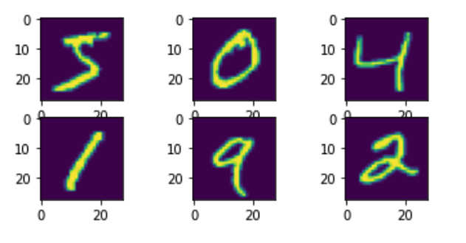
Data Handling
Data source
Dependencies
Preview

Slide 6
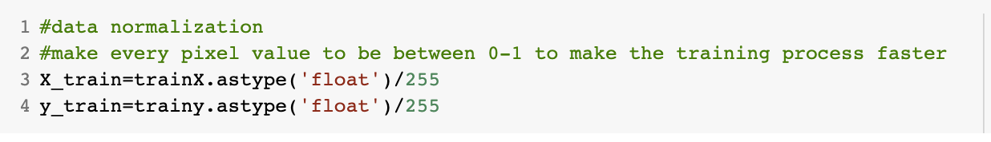
Data Preprocessing
Normalization
Flattening

Slide 7
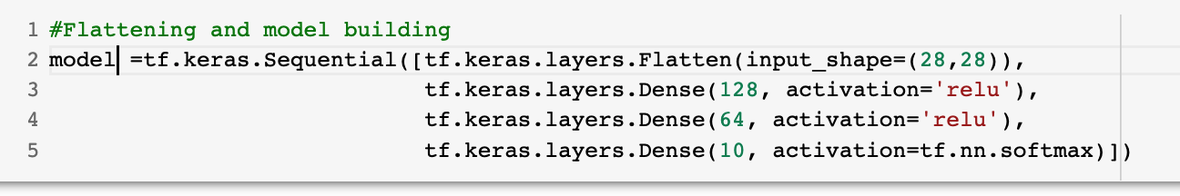
Model Creation
TensorFlow
Keras
Dense
Sequential
Activation function

Slide 8
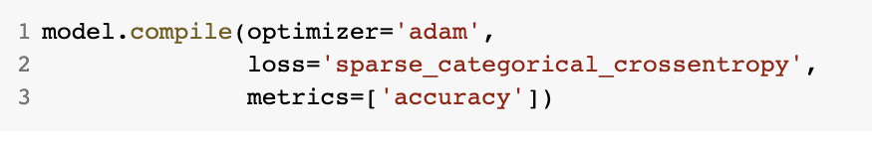
Model Compilation
Optimizer
Loss
Matrics

Slide 9
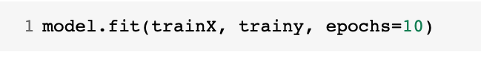
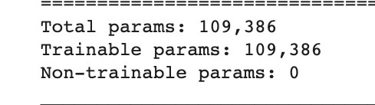
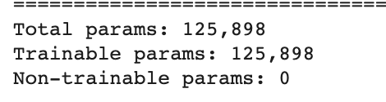
Training
Data split
Supervised learning
Labels
Notes:
Training data 60, 000
Supervised learning = 10 labels

Slide 10
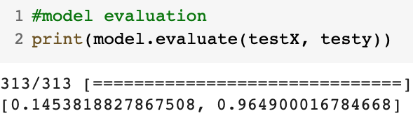
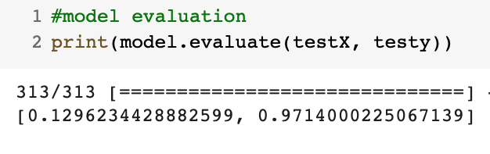
Testing
Data split
Evaluation
Notes:
1, testing data = 10,000
2.

Slide 11
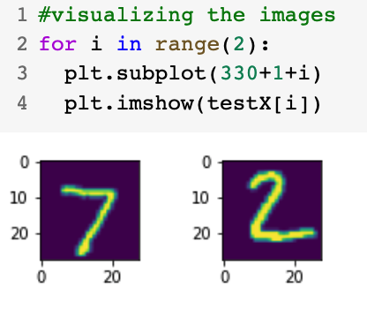
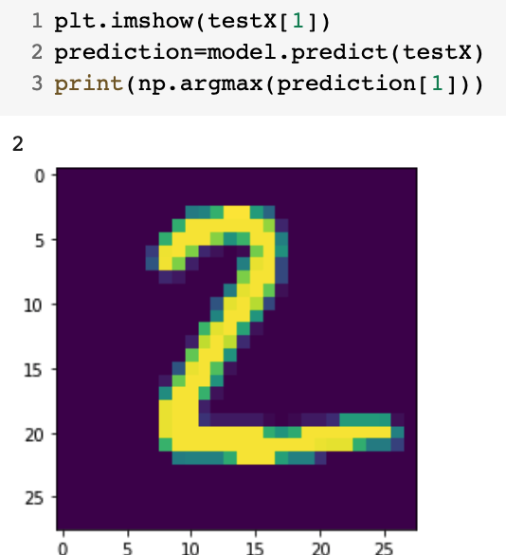
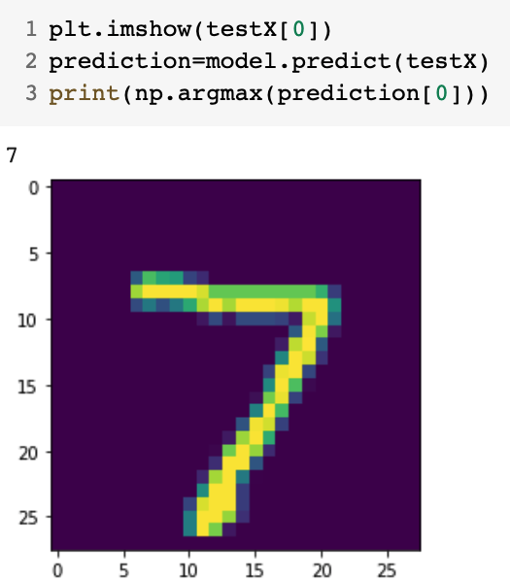
Output
Abra Kadabra
Notes:
prediction max the number the max probalitiy

Slide 12
Conclusion
Achievement
Challenges
Project benefit

